Slide 1
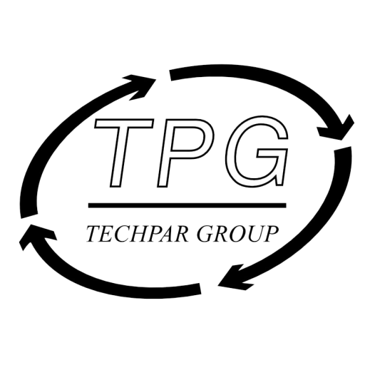
Blockchain and Distributed Ledger Technology
Gonzalo F. Dionis, Hanjin Hwang, John Licciardello, Minjun Chen, Arya Harsono

Slide 2

TechPar Group
Excellence, Expertise, Experience, Ethics
TechPar Group consists exclusively of high-level, high-achieving IT executives who have already achieved extraordinary levels of success. As industry movers and shakers, and leaders who made their mark while making a difference, TPG Advisors are brought into the firm based on both their stellar credentials and their willingness to now put their hard-won experience to work.
Blockchain & DLT Capstone
Applications for the Emerging Blockchain Ecosystem
Blockchain technology has the potential to disrupt the way society and businesses interact. From crypto-currencies to supply chain management, distributed ledgers can provide a decentralized answer to many of the problems we face today. This capstone project will work in collaboration with TechPar Group to assess and quantify this opportunity in a number of different sectors.

Slide 3



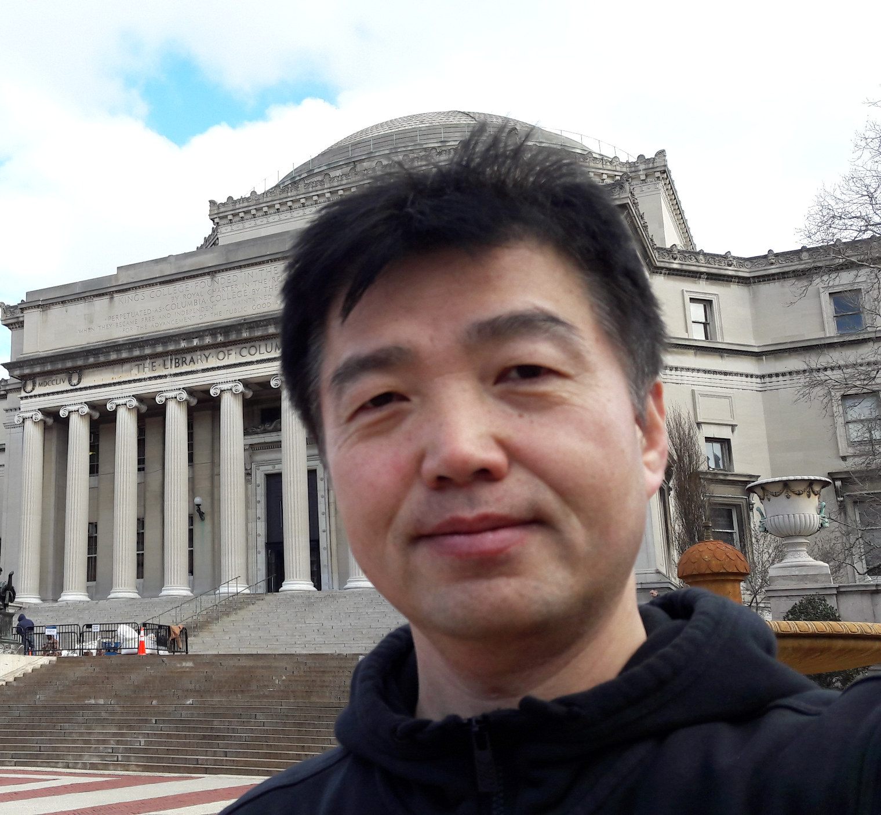


TPG Capstone Team
Gonzalo Fernandez Dionis, CFA
Studied Law and Economics in Spain, Singapore and France.
Financial analyst in the Telecom, Media and Technology space in London
Master Candidate specializing in Economic and Monetary Policy.
John D. Licciardello
Worked in IT and Finance for fintech startup in Mexico
MIA concentrating in International Finance
Undergraduate degrees in Engineering and Economics
Currently Managing Director, Ecosystem Development Fund at the IOTA Foundation
Hanjin Hwang
Studied Applied Statistics in South Korea and worked in Ministry of Science and Technology for the Korean government
MPA specializing in international finance and economic policy
Arya Harsono
MIA concentrating on Enviro Policy and Tech, Media,
Communications
Prior work in LA film industry and sustainable investment firms NatureVest, CCSI
Minjun Chen
MIA/MBA 2019
interned in Transaction Banking at Standard Chartered Bank
worked in non-profit, media, and R&D and innovation consulting

Slide 4
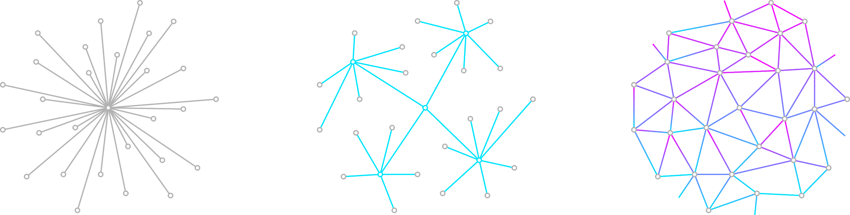
What is Blockchain and Distributed Ledger Technology?
Centralized
Distributed
Decentralized
Banks and Retail Outlets
Google Cloud, AWS, etc.
Distributed Ledger Technology &
The Internet

Slide 5
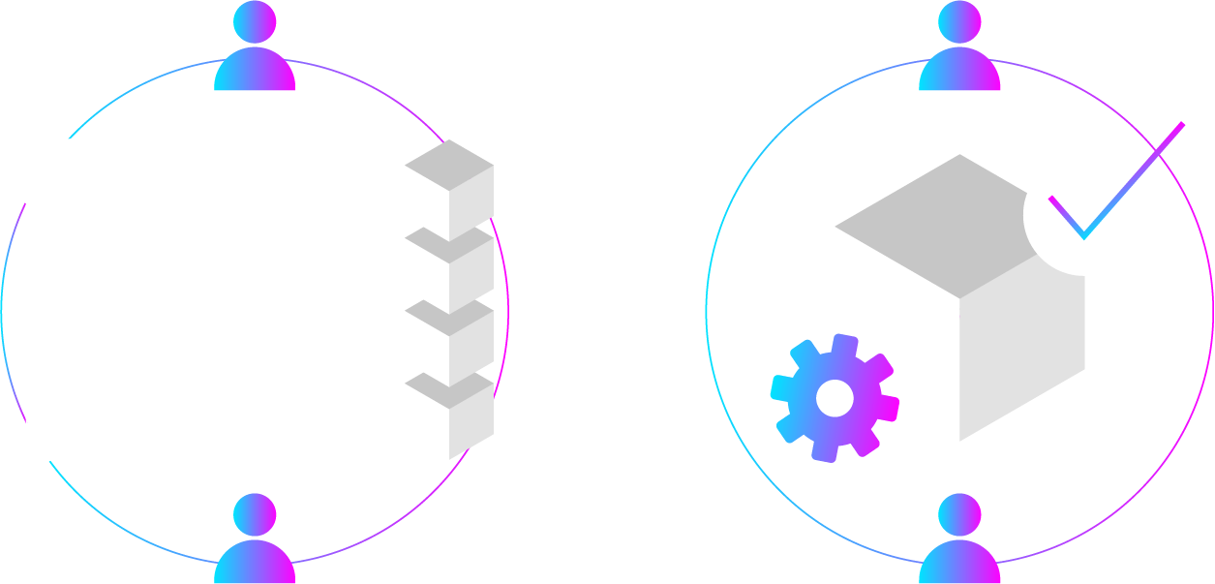
How does it work?
Notes:
Rather than relying on a centralized entity to maintain a ledger/database, independent and anonymous nodes are able to do this in a trustless environment
By rewarding honest behavior, an anonymous network of nodes can come to an agreement, settle discrepancies, and protect against attacks
This is done through various incentive schemes such as Proof-of-Work, Proof-of-Stake, and others

Slide 6
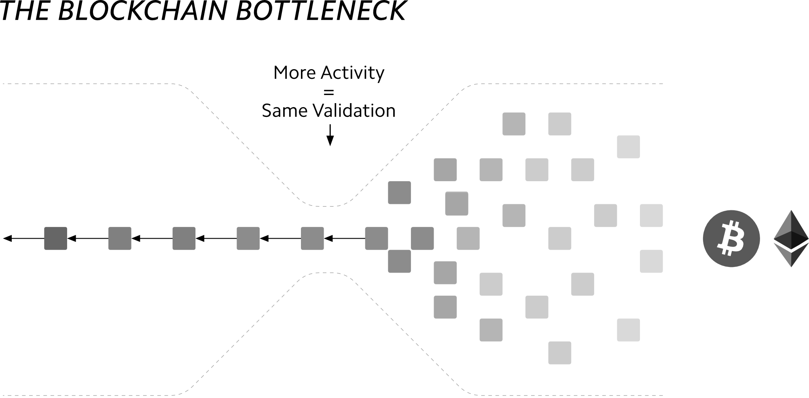

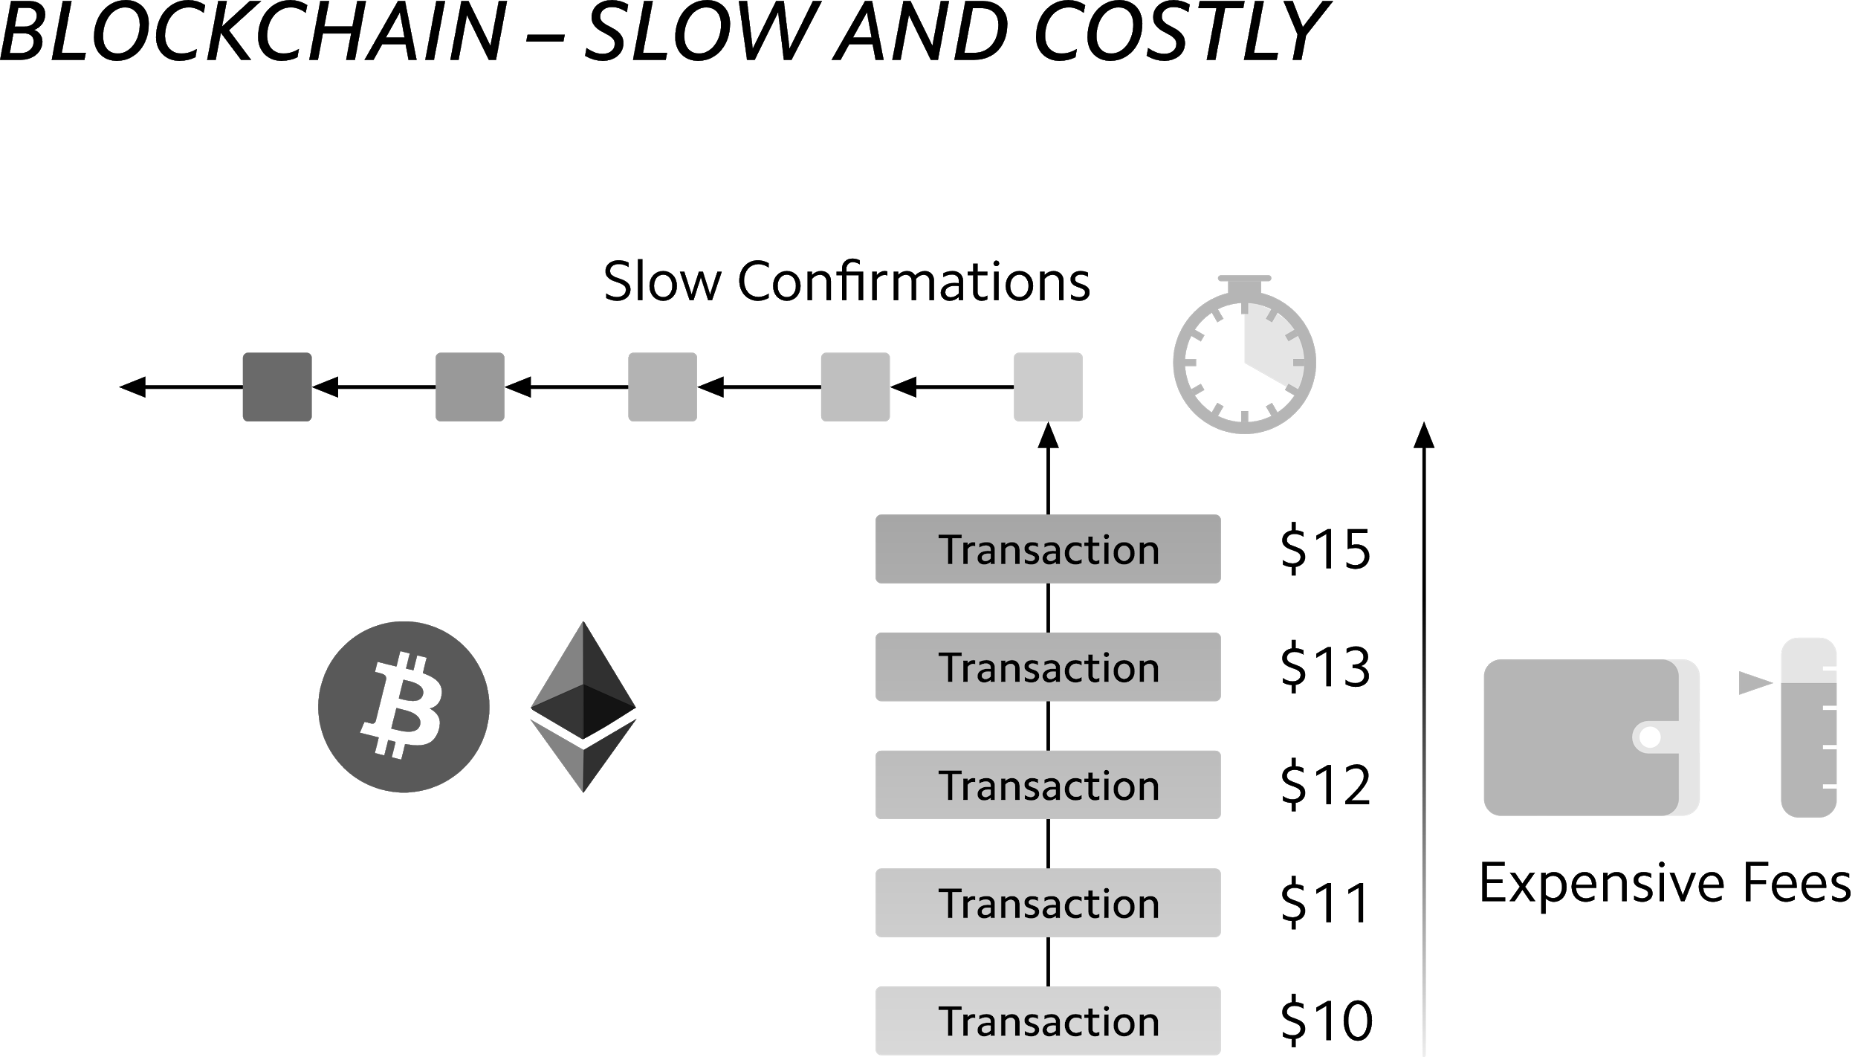
How Blockchain Works

Slide 7
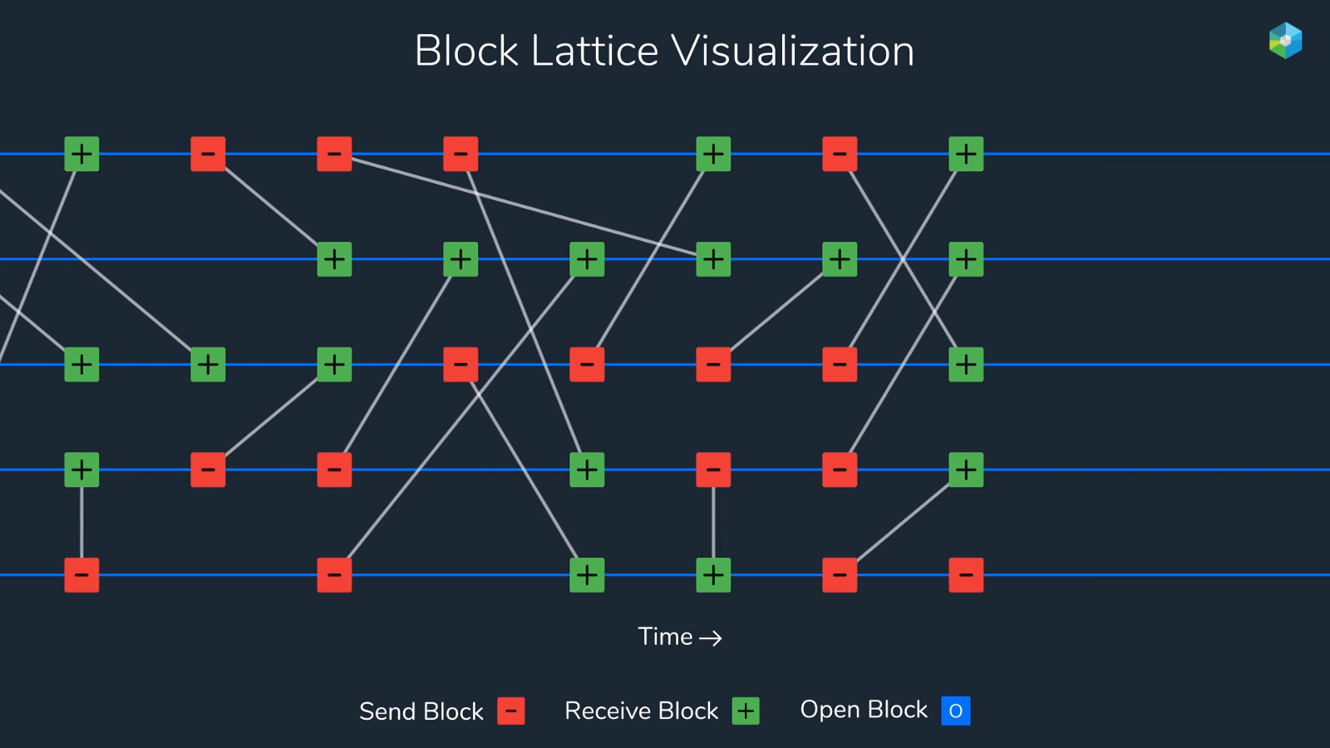
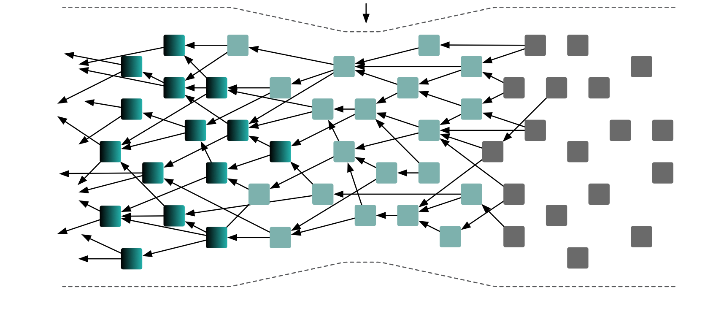
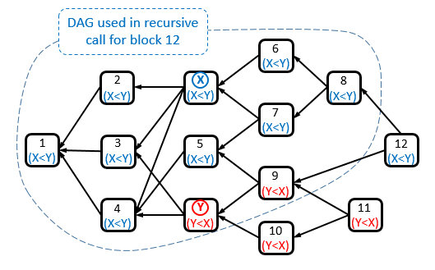
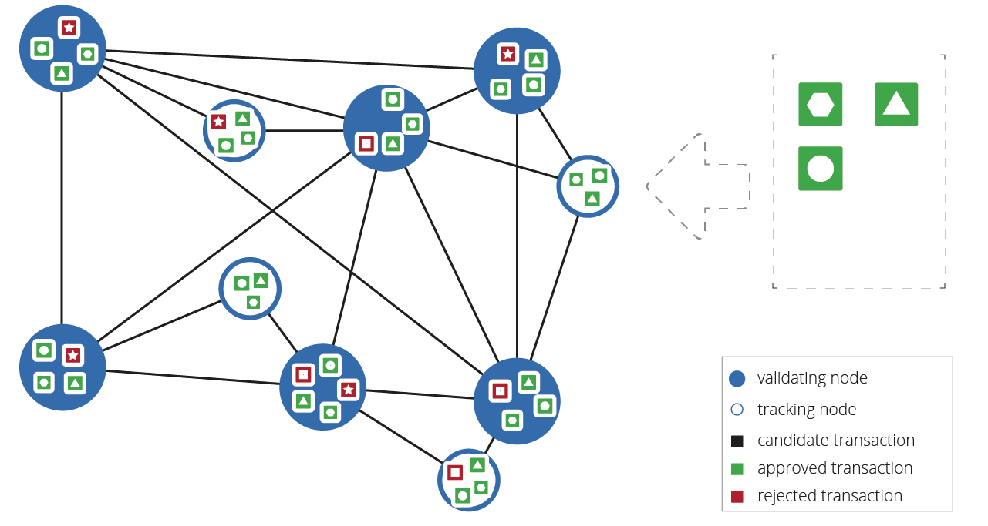
Other Consensus Algorithms
IOTA’s Directed Acyclic Graph (DAG) ‘The Tangle’
Nano’s Block Lattice
SPECTRE’s Block DAG
Ripple’s Trusted Nodes

Slide 8
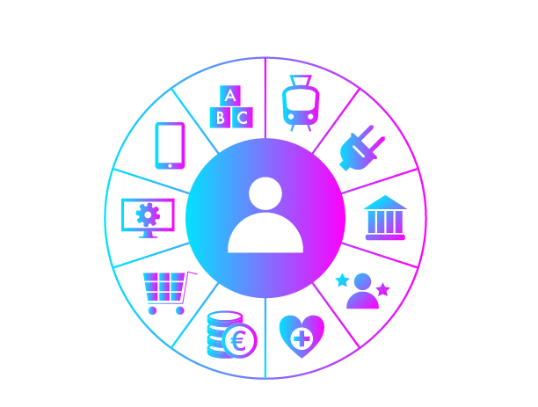
Industry Verticals

Slide 9
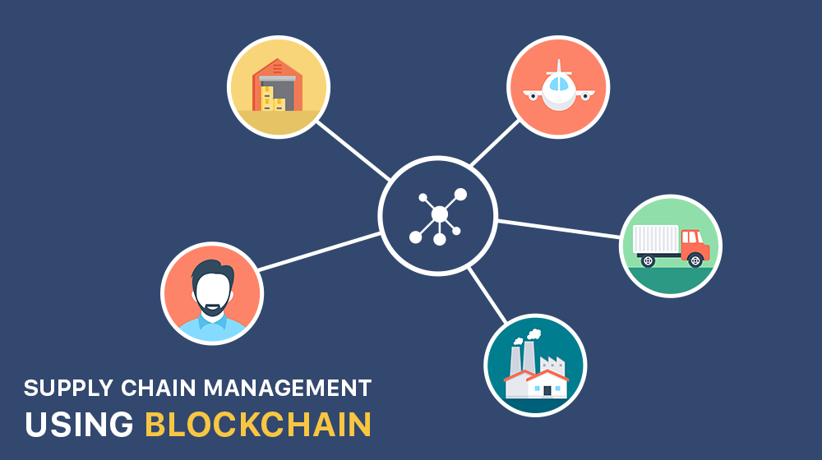
Supply Chain & Financial Service
Notes:
First area to explore is supply chain and financial services. We’re focusing on this industry bc of the size, and bc of the potential for cost reduction and increased efficiency through technologies such as blockchain.
Trade is $4T industry, financial services tied to it bc documentation involved with moving goods from one place to another place, WEF estimates efficiency in reducing trade barriers, including blockchain tech would reduce costs by 15%, ⅕ of transport cost is paperwork. We believe blockchain could be a huge contributor to this cost reduction by making
Financial services industry very complex, lots of players, intermediaries, institutions, government, regulators that all take part in some part of a transaction. This makes the transaction approval process very slow, lack of transparency around where documents and transactions are in the whole process, who is currently responsible for them, and who all the players are, and nowhere do you see this more than in the supply chain/trade finance process. This is where blockchain can come in, leveraging the distributed ledger to make things more efficient, more transparent, potentially cheaper, and faster. Let’s dive a little deeper into the current supply chain process and how blockchain could change that.

Slide 10
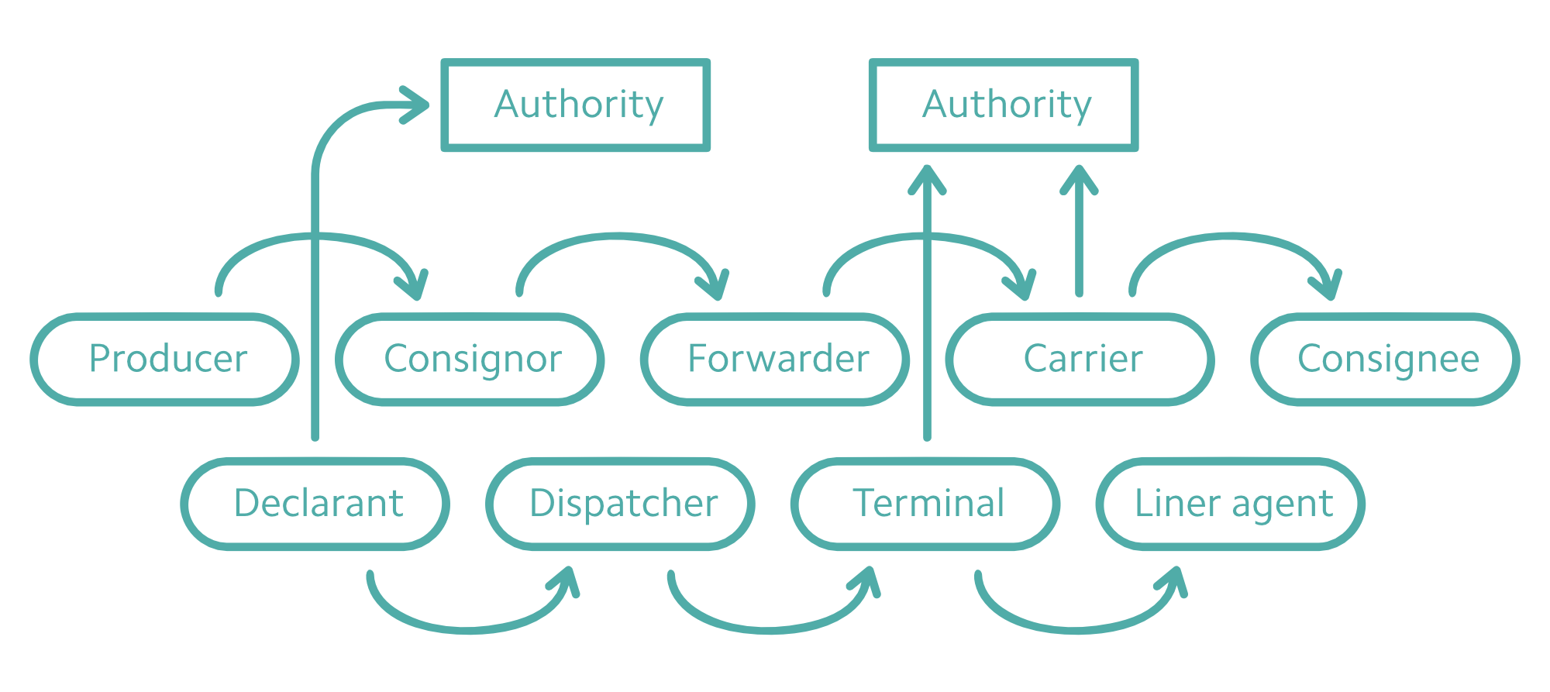
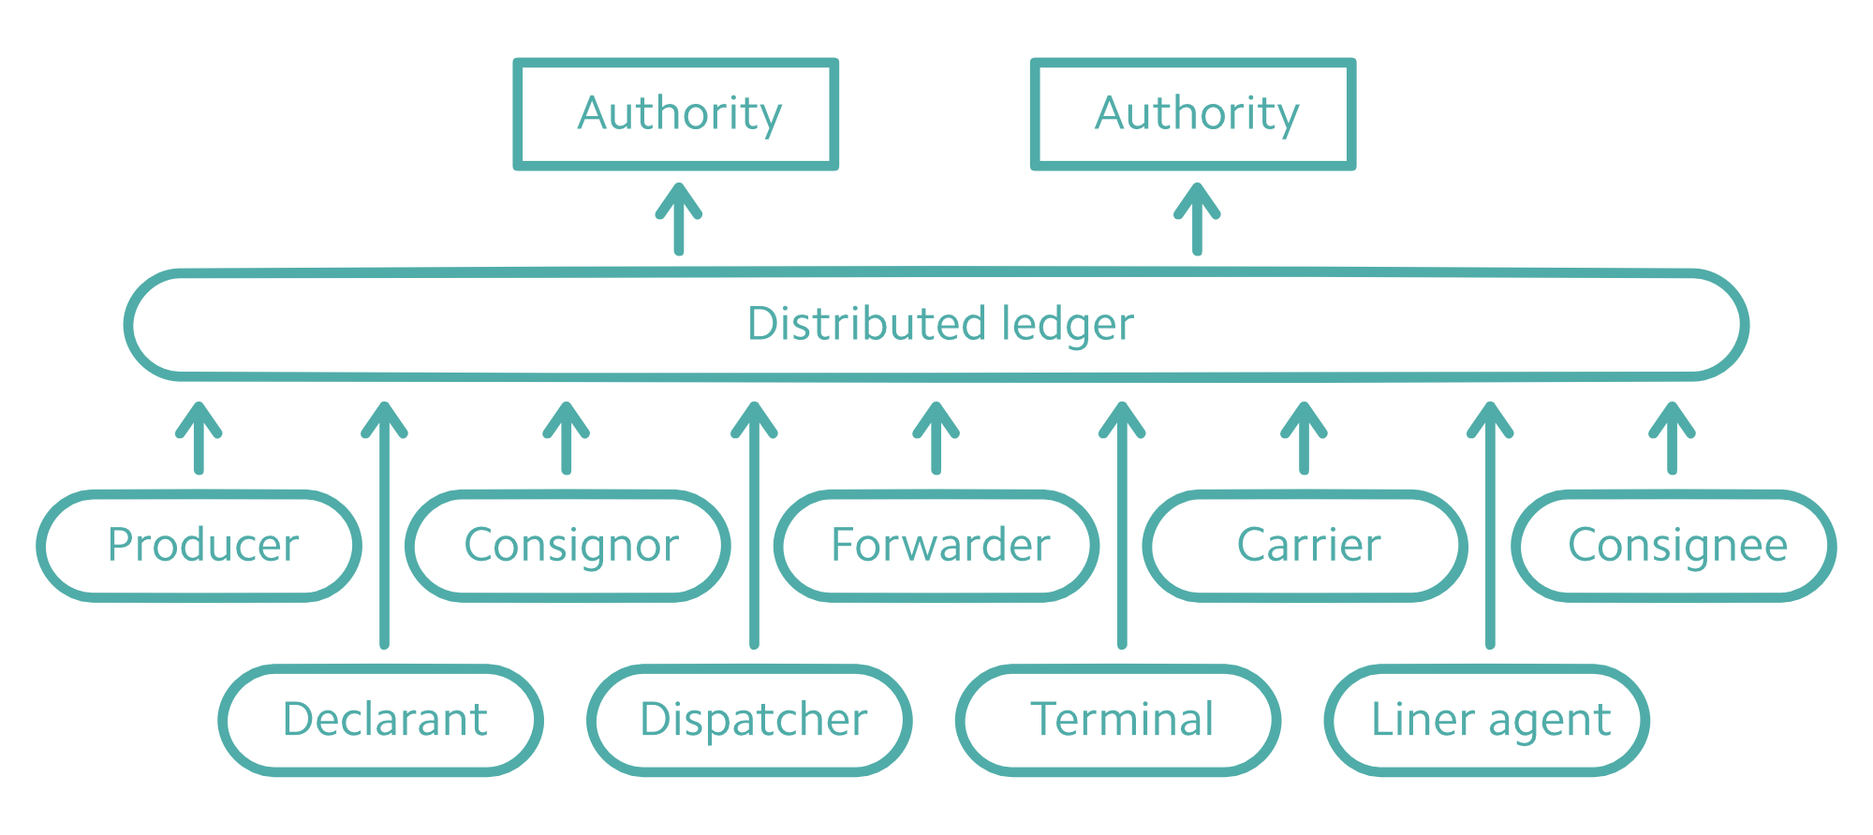
Financial Services & Supply Chain
Today
Tomorrow
Notes:
Currently, many MNCs have very complex international supply chains that span the gamut, and have many different participants. For instance, if I was Chevrolet, I would be ordering a car seat from my manufacturer, who in turn sources finished parts from another supplier, who sources raw parts from another supplier, so on and so forth. The business environment and market forces are constantly changing, and therefore there is a lot of fluctuation in my supply chain, as new suppliers join, and others drop out, and still other parts of the supply chain go obsolete as we decide to phase out certain products and develop new ones. This lack of visibility causes issues, as it’s hard for me as Chevrolet to track these various parts back to the individual supplier for quality control, to follow up when there are delays, and even in the case of products defects that lead to recalls. In fact, companies spend a lot of time in admin costs and follow up, trying to pinpoint where things are in the process. In addition to all the suppliers in my supply chain, there are also many intermediaries for all the documentation in my process, the government regulators who conduct quality checks on the products, as well as the various officials at the ports, trade officials etc that verify documentation. All of these players make this a messy process that is very opaque and difficult for Chevrolet to manage.
The blockchain would change that, by having all the parties involved communicate with each other on a distributed ledger, improving transparency, traceability, and lowering admin costs. In this case, the blockchain allows for the flexibility that is necessary in a changing business environment, so Chevrolet can manage the process, get the information they need, and see where things are in the process even when various parties join/exit their supply chain, despite not having a personal relationship with all the various parties in the supply chain. In addition, when it comes to documentation, they can add info to the various blocks to keep track of what’s been approved, who’s approved it, at what time, what location, etc. Financial services is layered on top of that in terms of trade finance/supply chain documentation between all the various parties in the process.
Incentive for each member to be on the blockchain. Chevrolet: better manage all the parties even if dont know them, can go to point of origin, supplier: dont have to complete Same paperwork a billion times, their paperwork is viewable by other potential buyers, helps them. Authority (port/regulator): verifying and make sure all approvals and documentation in place at each step of the process.
Gonzalo will now talk about two use cases for leveraging blockchain for supply chain

Slide 11
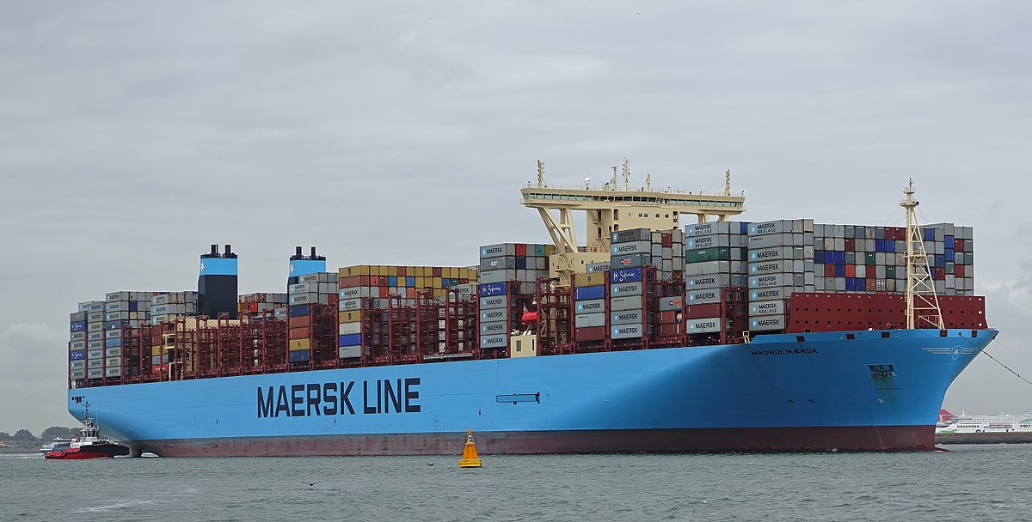
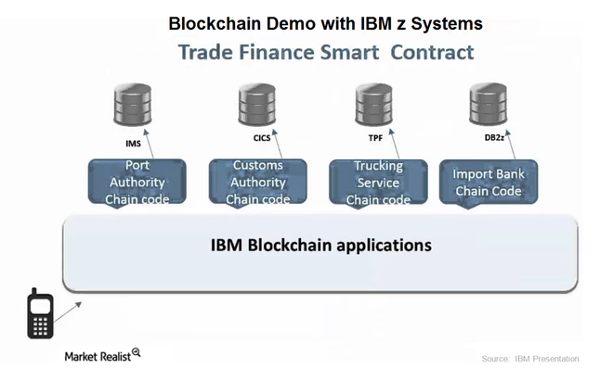
Financial Services for Supply Chain - IBM Partnership
Maersk
  Increasing efficiency across international supply chains
  Reducing global trade barriers
  Connecting the entire supply chain ecosystem.
Batavia
  UBS, BMO, Caixabank, Commerzbank and Erste Bank
  Blockchain technology that is designed to track goods and automatically release payments
Notes:
https://www.ibm.com/blogs/blockchain/2018/01/digitizing-global-trade-maersk-ibm/
Since the collaboration started in June 2016, multiple parties have piloted the platform including DuPont, Dow Chemical, Tetra Pak, Port Houston, Rotterdam Port Community System Portbase, the Customs Administration of the Netherlands, U.S. Customs and Border Protection.
A broader group of global corporations have already expressed interest in the capabilities and are exploring ways to use the new platform, including General Motors and Procter and Gamble to streamline the complex supply chains they operate and Agility Logistics to provide improved customer services including customs clearance brokerage
The platform is built on IBM Blockchain technology, which is provided through the IBM Cloud and powered by Hyperledger Fabric 1.0, a blockchain framework and one of the Hyperledger projects hosted by the Linux Foundation
Please use the sharing tools found via the email icon at the top of articles. Copying articles to share with others is a breach of FT.com T&Cs and Copyright Policy. Email licensing@ft.com to buy additional rights. Subscribers may share up to 10 or 20 articles per month using the gift article service. More information can be found here.
https://www.ft.com/content/7dc8738c-a922-11e7-93c5-648314d2c72c
Batavia
The consortium said the system was designed to be used by many banks, vendors and regulators to reduce the time and cost of providing trade finance for cross-border transactions. It aims to use smart contracts — a way of encoding a process on to a blockchain system — to automatically transfer money as goods progress around the world

Slide 12


Financial Services for Supply Chain -
Startups
Skuchain
  Digitize its POs, Invoices, Bills of Lading, Letters of Credit or any documentation involved in a supply chain transaction and automate execution of those instruments based off secure triggers
Wave
  $100,000 cheese and butter exports
  Wave platform
  Guaranteed by Barclays
Notes:
https://www.ibm.com/blogs/blockchain/2018/01/digitizing-global-trade-maersk-ibm/
http://www.skuchain.com/popcodes/
http://wavebl.com/
The first trade finance transaction over blockchain technology was claimed by Barclays and Israeli start-up Wave last September when they guaranteed the almost $100,000 of cheese and butter exports from Irish co-operative Ornua to the Seychelles Trading Company. That condensed a process that usually takes seven to 10 days into less than four hours.

Slide 13
The Energy Sector
Renewable
Nuclear Fusion
Space tech
Finite
Accessibility
Efficiency
Architecture: Supply chain
Firms/Consumers: Smart contract
Blockchain
IOT
Smart Grid
Smart Mobility
Notes:
Fundamental issues in energy sector come from the fact that energy resources are finite. Moreover, energy industry is in insufficient accessibility and lack of efficiency.
In order to resolve these issues many technologies are applied.
To search and develop new resources, tech using renewable energy, nuclear fusion, space exploration are developing.
To achieve accessibility and efficiency, IoT, smart grid, smart mobility tech are emerging.
Especially, blockchain tech gives new opportunities to energy industry.
For example, blockchain tech can restructure whole industry architecture by changing supply chain.
Blockchain tech also improve efficiency with smart contract.
Blockchain tech can be used to proliferate development of other tech.

Slide 14

Problems in the Energy Sector
Intermittency, esp. with renewables
High costs to balance supply and demand
Too many parties to trust and manage
Inadequate production and consumption data management
Notes:
In order to decipher the viability of the applications of blockchain and DLT in the energy sector, we must identify what the true problems in energy that only blockchain and DLT can solve.
The goal of utility companies and their grid is to ensure that supply reliably meets demand. With a dying coal industry and fossil fuels on the way out, renewable energy options need to be more viable. But most suffer from intermittency issues, and thus their output is unpredictable.
Energy consumption is, on the other hand, more predictable, but highly cyclic, varying by time of day and season. This builds pressure on the grid to balance supply and demand. A relatively new solution is using batteries for storage, but at the moment the technology is still quite costly to implement, especially at a large scale.
The energy sector is comprised of producers, distributors, and consumers. With the advent of clean energy applications to homeowners, consumers can become producers as well – they become “prosumers”. With increasing variety of production sources, there are too many parties involved – you have various utility companies, grid operators, transmission operators, consumers (and now prosumers), making it difficult to trust and manage energy use centrally.
Moreover, there may be issues with delinquent buyers, who may not pay fairly or timely for their electricity.

Slide 15

The Blockchain “Solution”
The Vision: A decentralized and permissionless future with frictionless interactions
Blockchain and DLT suitable if:
  The use case requires direct payments without contracts
  The use case needs immutable data storage
  The use case requires non-repudiation parts to ensure accountability
Notes:
So, how can blockchain solve these problems? And how is blockchain different from other technologies? It offers decentralized, permissionless, and frictionless interactions and therefore eliminates the need to manage the process.
In a decentralized future with permissionless interactions, energy providers can manage customers without a central database through direct P2P trading and communication. The blockchain adds a trust layer, similar to the one we see in the applications for supply chain management. Moreover, it would allow for more transparency regarding consumption data, giving more control to the consumer to manage their own energy use
Using a tokenized architecture, blockchain and DLT can also incentivize consumers to balance out the grid by rewarding tokens for scheduling their electricity use in order to reduce demand at peak times. By pacing the charging of electric vehicles, for example, a blockchain application prevents the grid from blowing out. The tokens can also be used to pay for electricity bills and potentially be redeemable for more tangible benefits, such as fiat currency. As such, blockchain more efficiently allocates resources and reduces transaction costs.
Blockchain would develop an immutable ledger, eliminating delinquent buyers and thus remove accounts receivable and the need for disintermediation. For instance, there is currently some issues with smart meters, in which individuals can use multiple meters under different accounts to avoid paying certain costs. In other words, where the sum of meters should equal to transformer delivery, it doesn't. There is a need to research detection methods, and DLT seems a viable use case for this.
As we are still in an early phase of developing the technology for the energy sector, there are very little indicators of success for these use cases. As such, it is important to observe these use cases as they develop, and see what’s working and what’s not - what’s working for one use case may not work for another. (The idea is to say that there is no standard and that each application of blockchain comes with the same amount if not more risk)
But there are certainly use cases that do not necessarily require a blockchain or DLT element. Based on interviews with experts, we see blockchain and DLT as suitable if:.
o Direct payments without contracts
o If you need immutable data storage
o If you need non-repudiation parts in a way that if a customer says I didn’t charge then the record is there and it is unchangeable

Slide 16
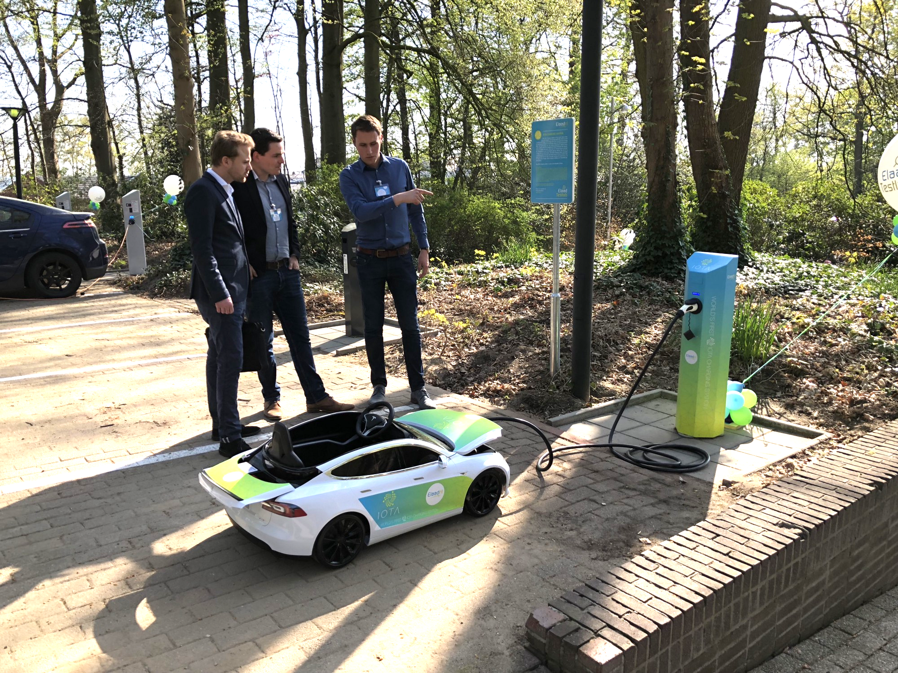
Case study: IOTA Charging Station
Notes:
We had the privilege to speak with Harm van der Brink, who recently released the IOTA Charging Station in the Netherlands. Partnered with Dutch grid operator INEXIS, the charging station combines E-Mobility and Smart Charging - the car has a digital wallet, can directly interact with charging station with minimal human interaction, and controls energy flow towards cars from grid via immersion technologies like blockchain. This is a particularly useful use case because the current system for charging stations deters electric vehicle purchase and use. In February 2018, only 3.4% of new car registrations in the Netherlands were EVs.
EV owners and users across Europe are required to have a national contract with the sales provider to charge at these stations. This is not suitable as it requires interaction with multiple parties just to use the vehicle. The IOTA charging station provides a platform to connect these different parties and share data. As this was only released recently, we cannot conclude its scalability, but it is promising.
Here is a quick video of Harm explaining how it works.

Slide 17
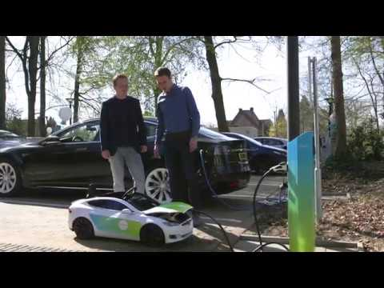

Slide 18
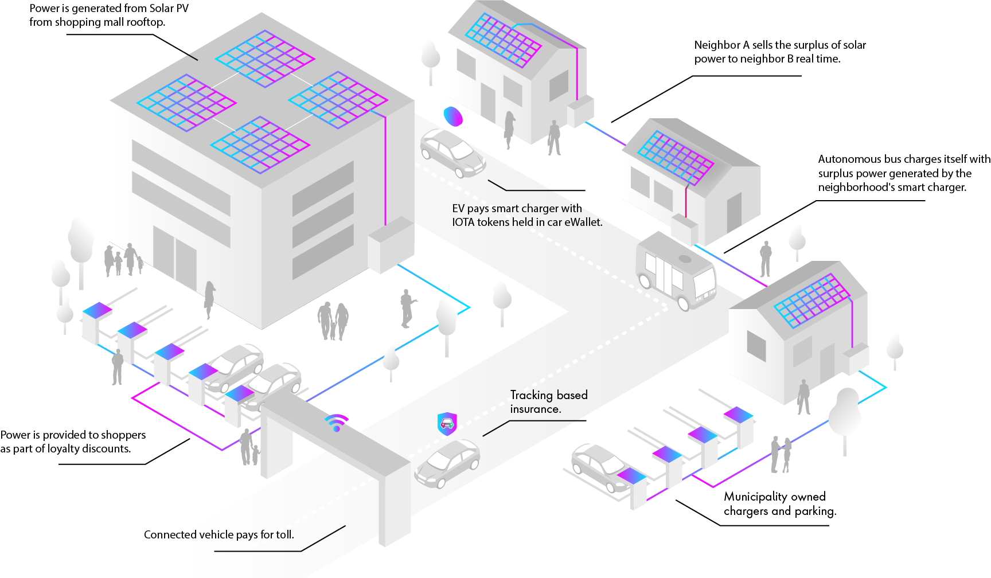
Notes:
This graphic demonstrates that potential future for the energy sector with blockchain and DLT. We have independent producers using solar panels on residential and commercial buildings. There is direct P2P trading between neighbors. Commercial buildings can provide power for electric vehicles in parking lots, and charge public transportation.
But as we’ve seen with the IOTA Charging Station, to realize the full potential for blockchain in the energy sector, smart mobility is key. [Transition to John’s slides]

Slide 19
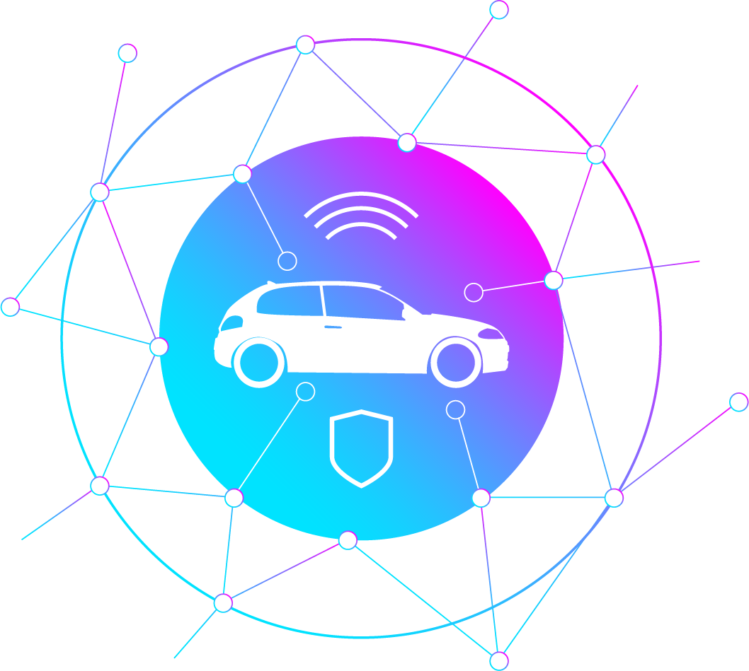
Smart Mobility & Artificial Intelligence
Autonomous vehicles need to be able to share information and resources securely, trustlessly and efficiently
These vehicles need to take information gathered and collectively derive intelligence from it, make decisions based on it and allocate resources accordingly
Doing this through a centralized cloud service is infeasible due to bandwidth and resource overhead constraints
A decentralized system of computations can effectively outsource this task to the vehicles themselves
Notes:
Once one car learns of something (road hazard, traffic, etc.) they all learn it and re-calculate the most efficient means of getting everyone to where they need to go
Those in a rush can compensate those not in a rush to allocate scarce resources (highway space) more efficiently.
Need this to be done in a trustless decentralized fashion

Slide 20
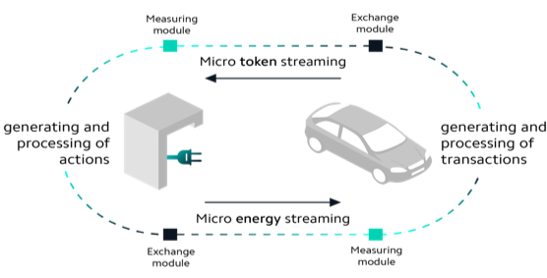
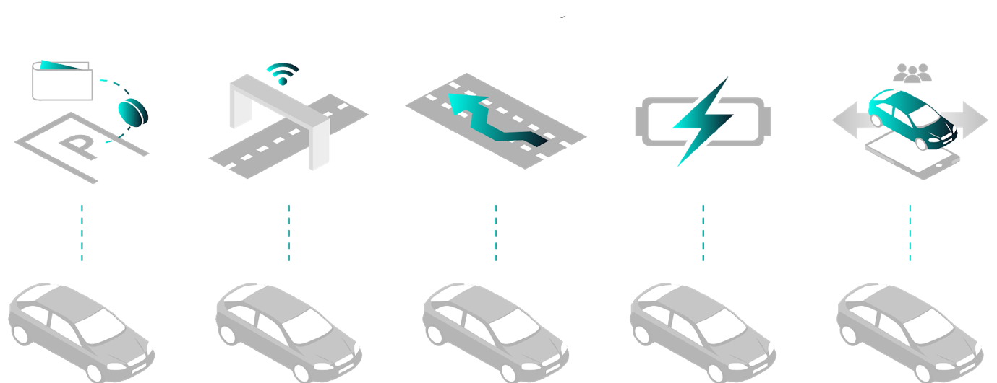
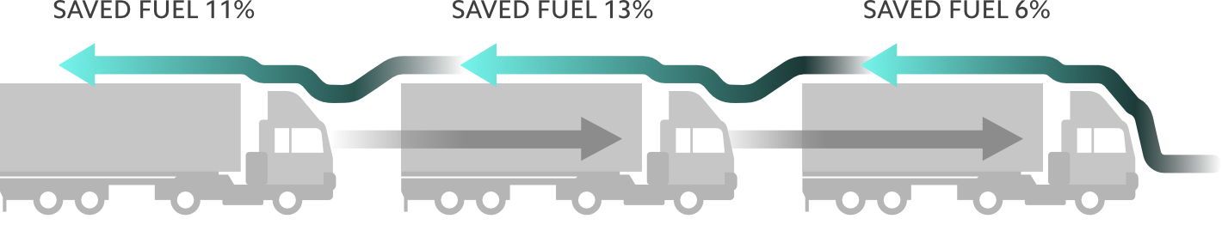
Real-Time Data & Payments
Mobility as a Service (MaaS)
Platooning

Slide 21
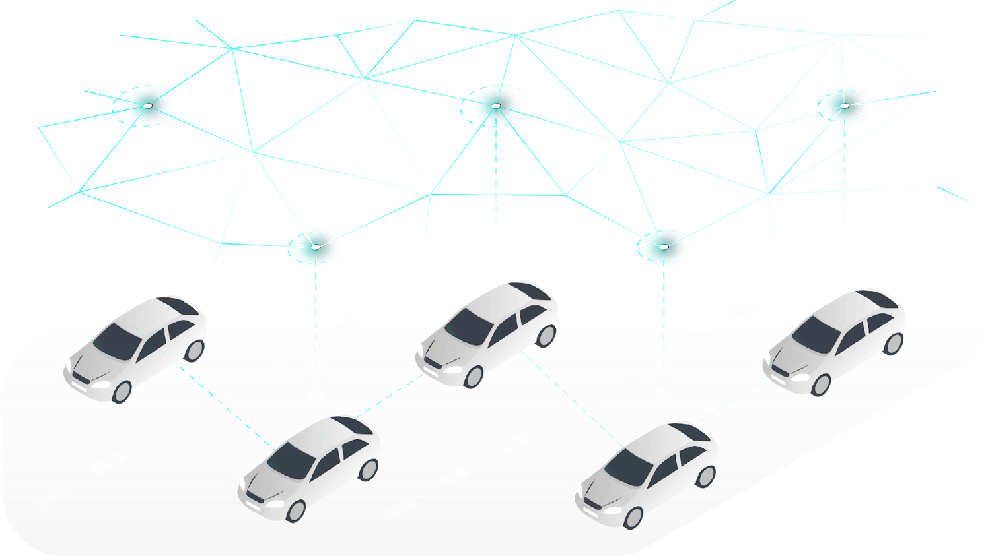
Over-the-Air (OTA) Updates

Slide 22
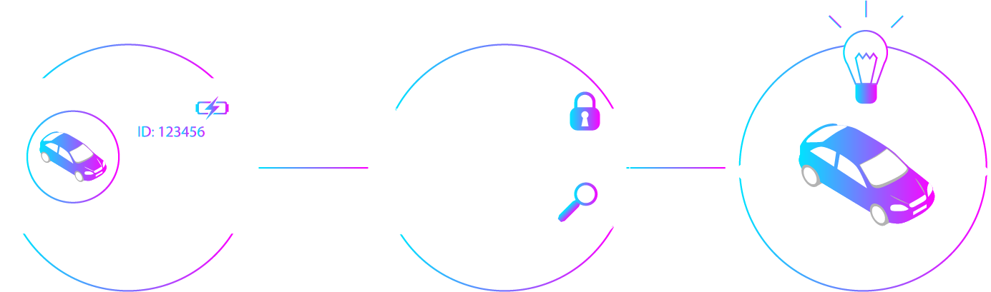
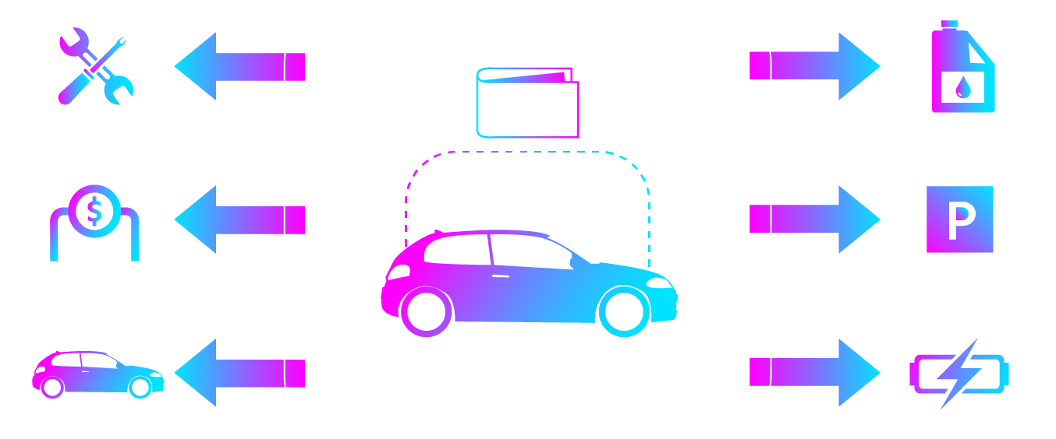
Digital Twins
Autonomous Economic Agents

Slide 23
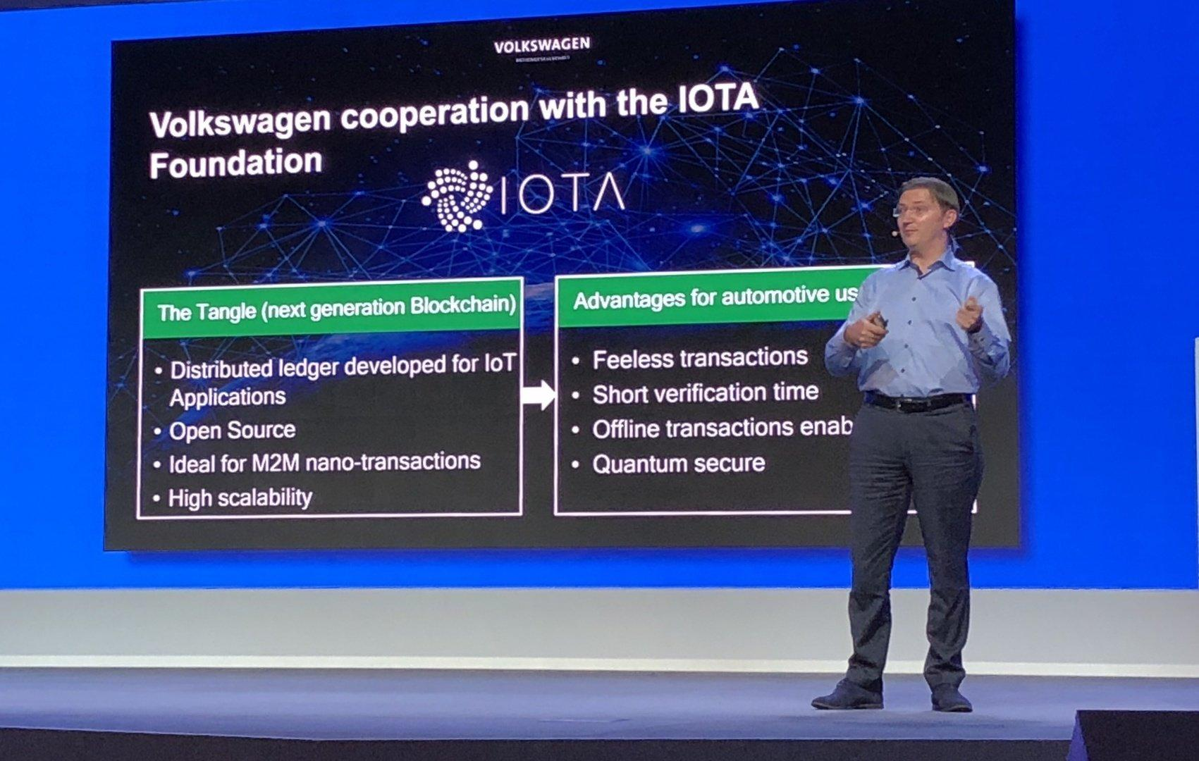
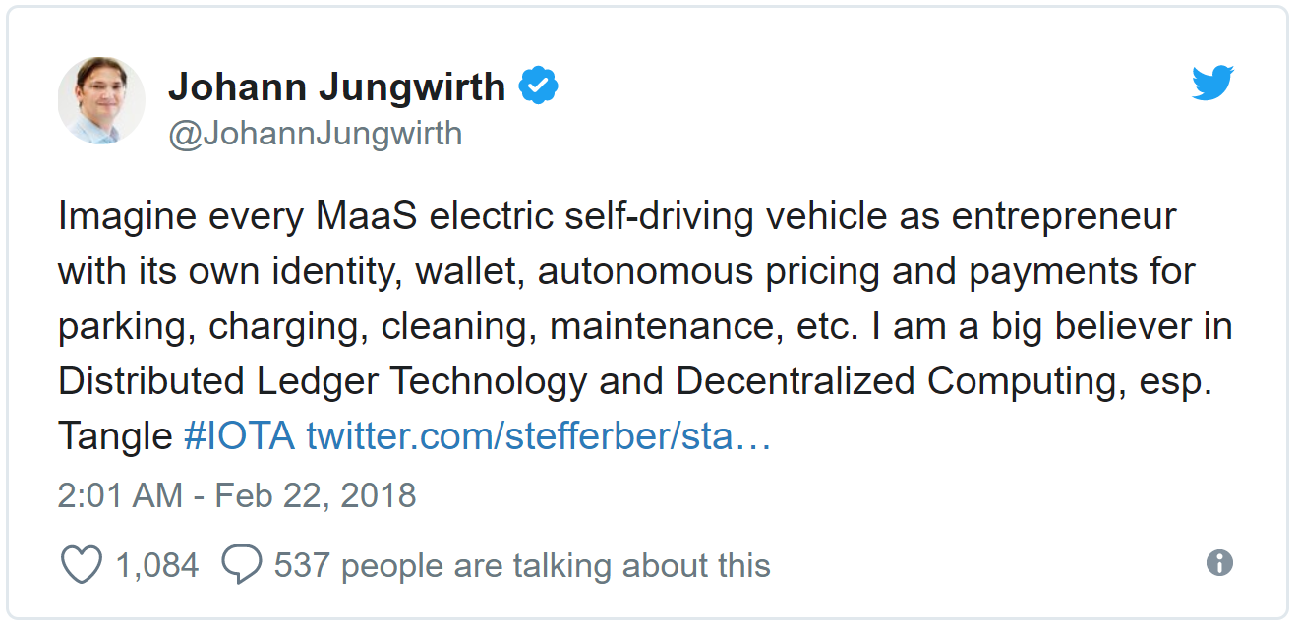
IOTA Foundation Partners with Volkswagen & the International Transportation Innovation Center (ITIC)
ITIC, in collaboration with the IOTA Foundation, plans to build a global network of open and closed testbeds to incubate and validate AI-based sustainable mobility services.
Volkswagen also recently announced a cooperation with IOTA, with the Chief Digital Officer, Johann Jungwirth, formally joining the IOTA Foundation’s Supervisory Board.
Notes:
IOTA partnered with these two organizations to develop some ‘Proof-of-Concepts’ but this is still very much in the early stages of development
MaaS = Mobility as a Service

Slide 24

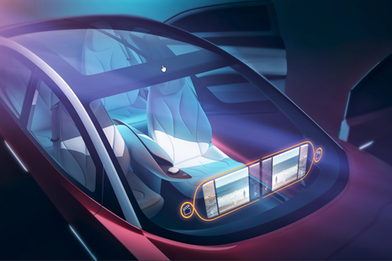
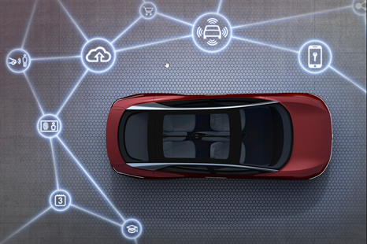
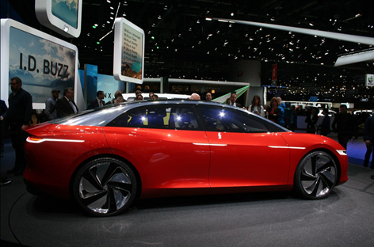
Notes:
This is the VW I.D. Vizzion revealed at the Geneva Auto Show in March of this Year.
This concept car has no steering wheel, no accelerator or brake but the first production version is slated for 2022 – that’s just 4 years away. The car sports 302 horsepower, has a range of 500-600Km on a single charge and will boast Level 5, fully autonomous capabilities, artificial intelligence and a holographic user interface making it a mobile entertainment center. Commuting just became attractive again.
VW expects to have 15 production vehicles based on the same MEB platform by 2025.

Slide 25

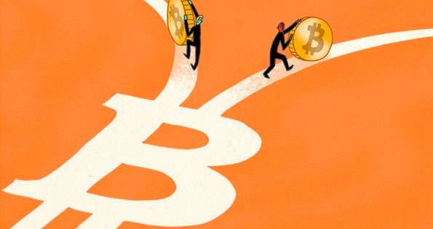

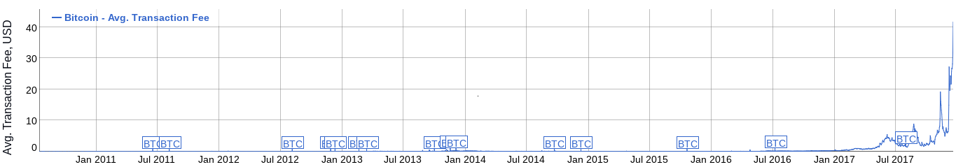
Risk and Challenges
Hard forks
  Bitcoin chain is now four: Bitcoin, Bitcoin Cash, Bitcoin Gold and Bitcoin Private
  Ethereum chain is now two: Ethereum and Ethereum Classic
Failed pilots
  Depository Trust & Clearing Corporation (DTCC)
  SIX Securities Services
Strong barriers to entry - path dependency
Security of the exchanges, wallets and applications
  Mt. Gox Bitcoin Exchange hack - $473 million worth of Bitcoin stolen
  DAO hack - $150 million stolen, then restored with hard fork of Ethereum
  Parity wallet lock - $280 million locked on Ethereum blockchain
Scalability and cost issues

Slide 26
Key Themes & Challenges
Blockchain & DLT technology can increase efficiency and trust between users and potentially cut transaction costs
Trade Finance: point of origin transparency and facilitate greater trust in supply chains allowing better financing
Energy: balancing supply and demand more efficiently, permissionless and distributed management of assets
Smart Mobility: safer, cleaner, & convenient ways of traveling: Mobility as a Service
Notes:
Terry Shane
The scarcity principle - the price for a scarce good will always rise until equilibrium is reached
"All proof-of-work blockchains are essentially based on achieving consensus by setting up competition for scarce resources"
"The system simply cannot scale to the demand that's coming"
"Blockchain is not as distributed as you might think"

Slide 27
Questions?

